Slide 1

Petfinder
If homes can be found for them, many precious lives can be saved — and more happy families created.

Slide 2

Our Mission
PetFinder.my has been Malaysia’s leading animal welfare platform since 2008, with a database of more than 150,000 animals. PetFinder collaborates closely with animal lovers, media, corporations, and global organizations to improve animal welfare.
Here we took the next challenge to enhance the platform decisions to increase the adoption speed for every possible Pet

Slide 3
Agenda
Presentation
Business Overview
Technical Overwie
Questions and Insights
Data Preprocessing
Feature Extraction
Classifiers
Mllib Approach
Map-Reduce Approach
Business decisions

Slide 4


Business overview

Slide 5
By looking at the data we asked ourselves about the effect of
The pet type
The pet age
Is there a significant difference in the adoption speed between dogs and cats in the dataset?
Does the age of a pet have a significant impact on its adoption speed?
The pet gender
The deworming
Is there a significant difference in the age distribution between male and female pets in the dataset?
Is there a difference in adoption speed whether the pet is vaccinated or not?
The Fur Length
Does increasing the fur length of a pet increase its chances of adoption?

Slide 6
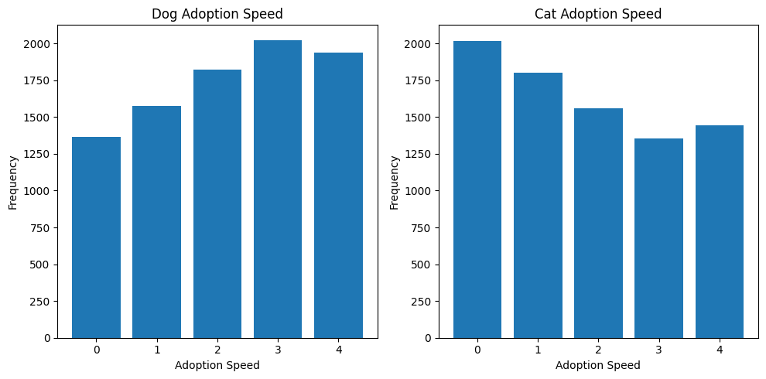
Dogs vs Cats
Is there a significant difference in the adoption speed between dogs and cats in the dataset? → Yes, on average the number of adopted cats in the less durations are more than dogs. However, the number of adopted dogs in longer durations is more than cats.

Slide 7
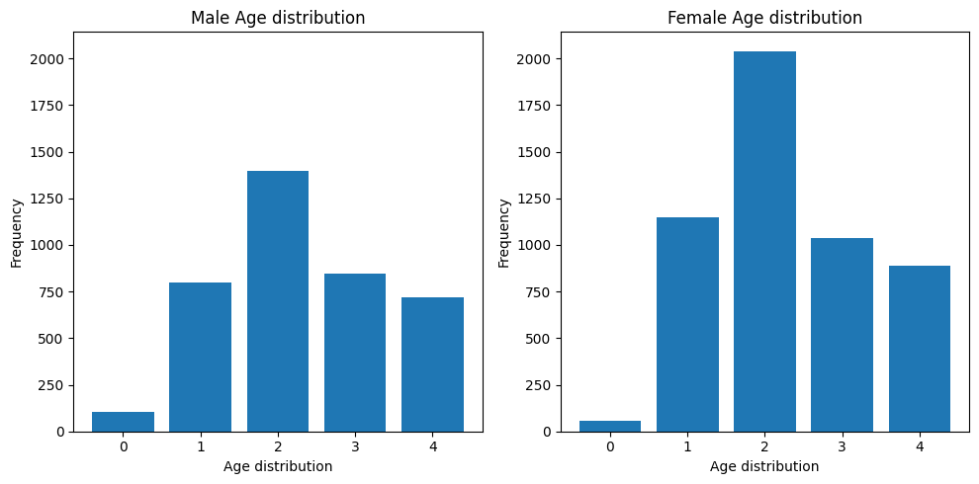
Males vs Females
Is there a significant difference in the age distribution between male and female pets in the dataset? → No, it came to our surprise that the age distribution between males and females is the same in the dataset.

Slide 8
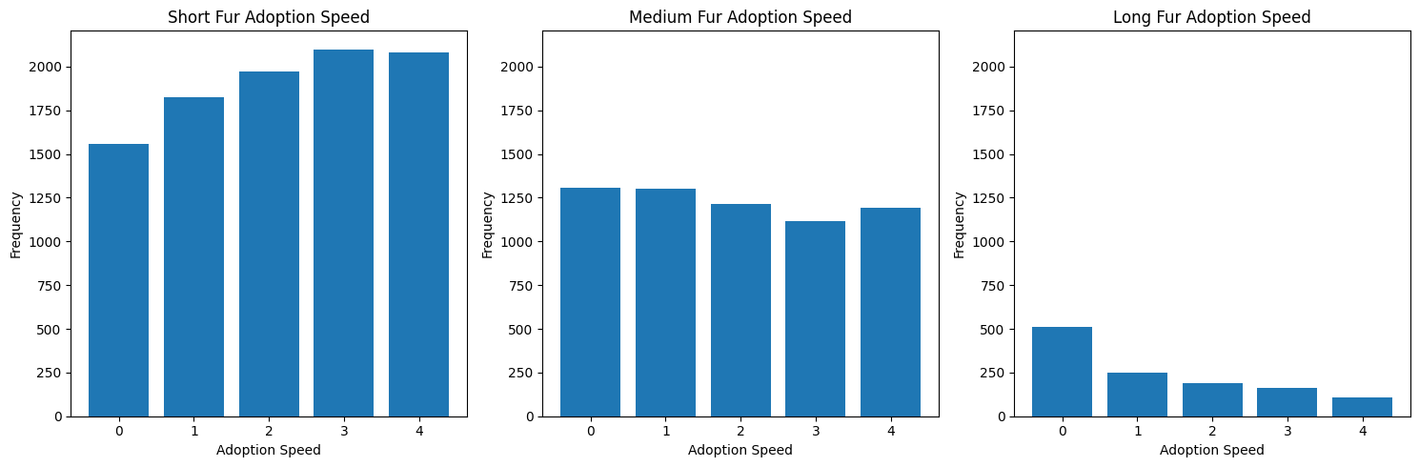
Fur Length
Does increasing the fur length of a pet increase its chances of adoption? → Yes, Although the pets with long hair are fewer the highest percentage lies in faster adoption speed regions.

Slide 9
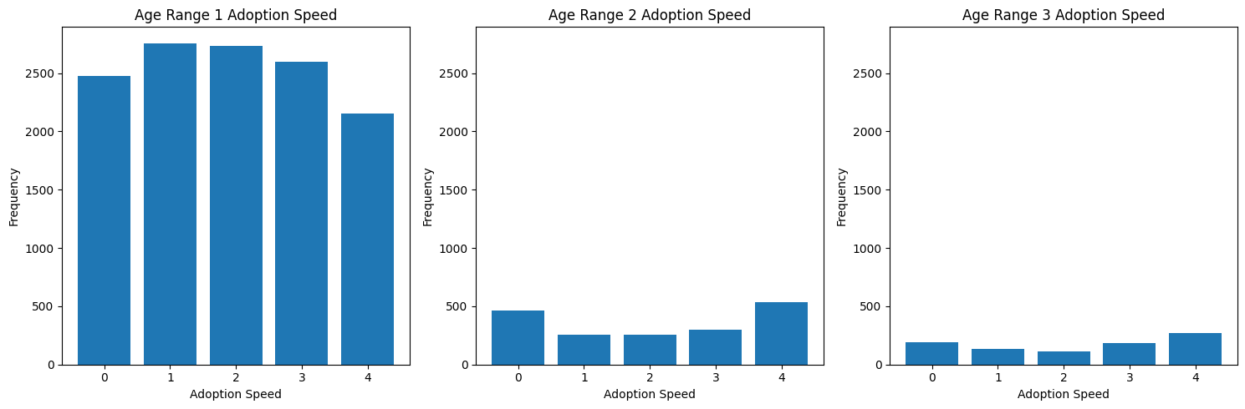
Age
Does the age of a pet have a significant impact on its adoption speed? → We have 3 ranges for age (in months):
0 - 12: most pets are in this range where they are most frequent at (2) adopted between 8 and 30 days (1st month) after being listed.
12 - 24: are most frequent at (4) no adoption after 100 days of being listed.
24 - 36: same as the previous range.

Slide 10
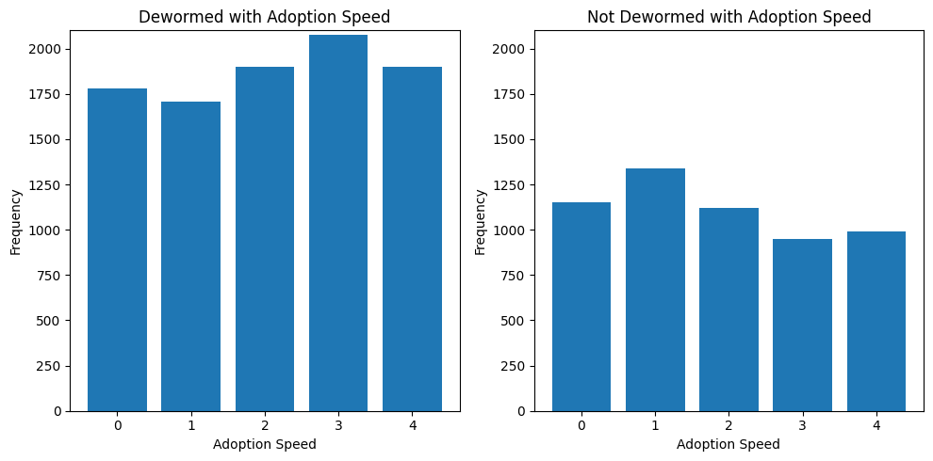
Dogs vs Cats
Is there a difference in adoption speed whether the pet is vaccinated or not? → Although most of the pets are dewormed, also they are the most adopted.

Slide 11
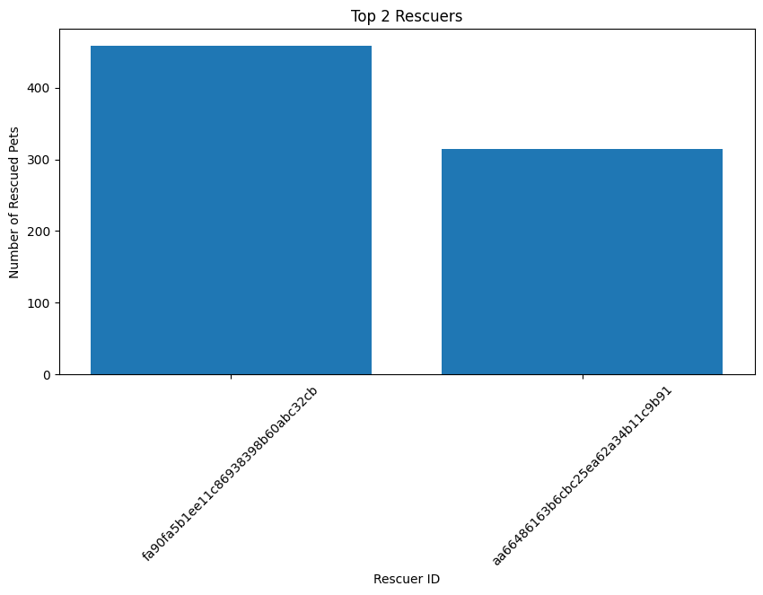
As a final question, we wanted to get the top pet rescuers
Get the top 2 rescuers' IDs using map-reduce to give them special rewards

Slide 12

Business decisions
From the previously extracted insights, we concluded the following should be done:
Increase the marketing for Dogs over cats to increase their adoption rates
There are special types of treatments that can be given to pets to increase their fur length (fluffier….faster adoption)
Reduce the adoption fee on every pet when it’s older
Deworm and vaccinate each pet before making it available for adoption

Slide 13

Technical overview

Slide 14
Project Pipeline
Data Cleaning and Pre-processing
Feature Extraction
Models Training
Extracting Visualizations
Applying PCA
Models’ Evaluation

Slide 15
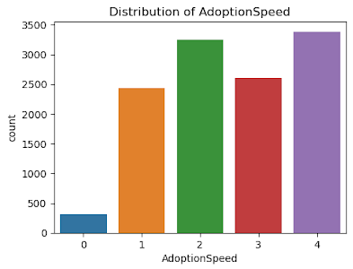
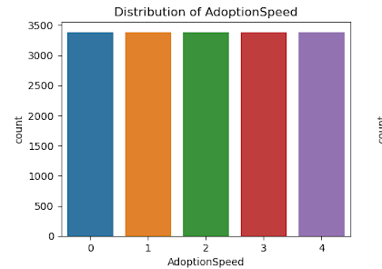
Data Cleaning and Pre-processing
Split the data into train, and test datasets (80 20)
Classes need to be balanced (class 0 has a very low count with the perspective of other classes). So, we used the RandomOverSampling method to deal with class imbalance.
Before Balancing
After Balancing

Slide 16
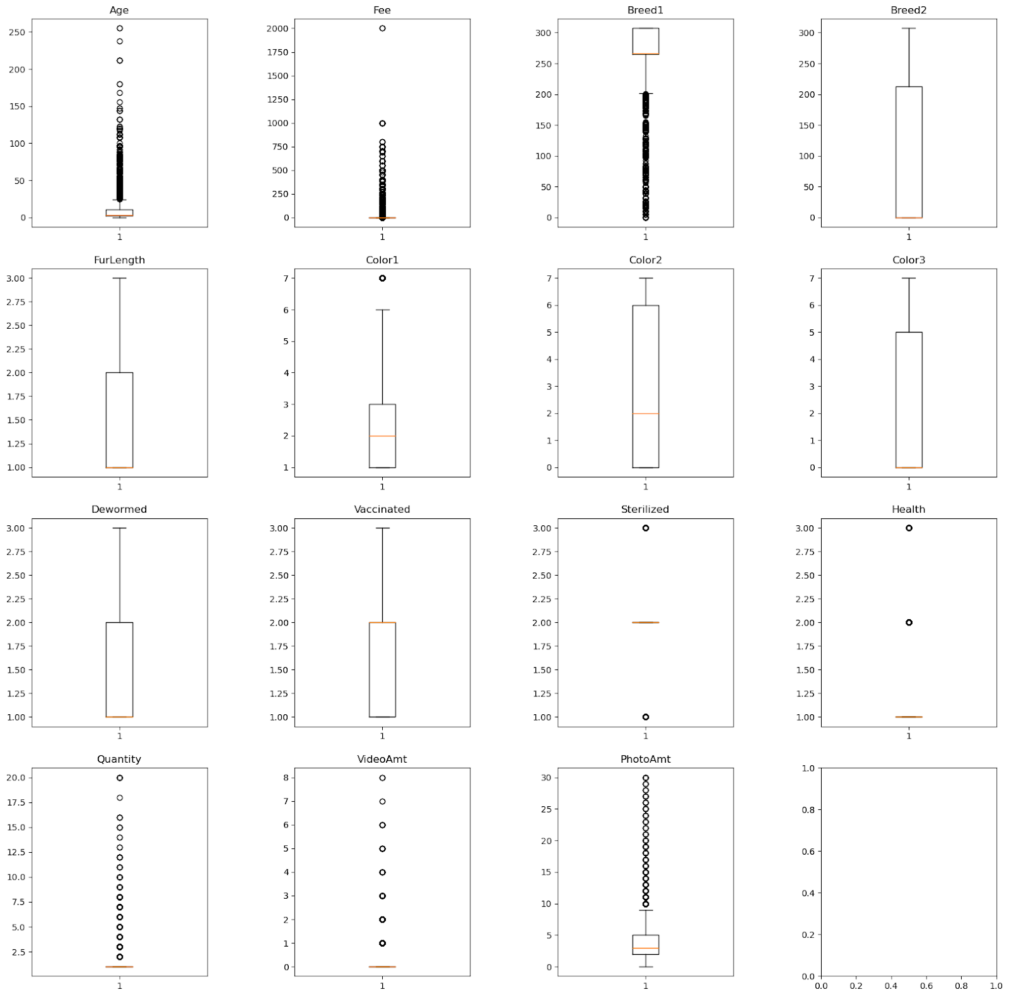
Data Cleaning and Pre-processing
Used boxplot to check for any outlier in all columns to be removed from the dataset or transformed using log transformation techniques to reduce their impact on the model's performance

Slide 17
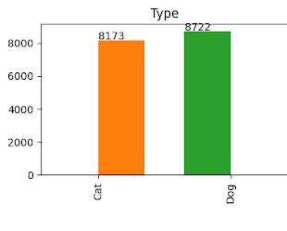
Extracting Visualizations
We applied multiple visualizations to view the distribution of each category and column in the dataset.
When we received the dataset in the first place, all feature values were encoded ( another file for each feature was provided to explain each code). So, we put extra effort to map the values and make meaningful distributions
Also, we wanted to split the distributions on each feature between Cats and Dogs to help us in the Extracting insights phase

Slide 18
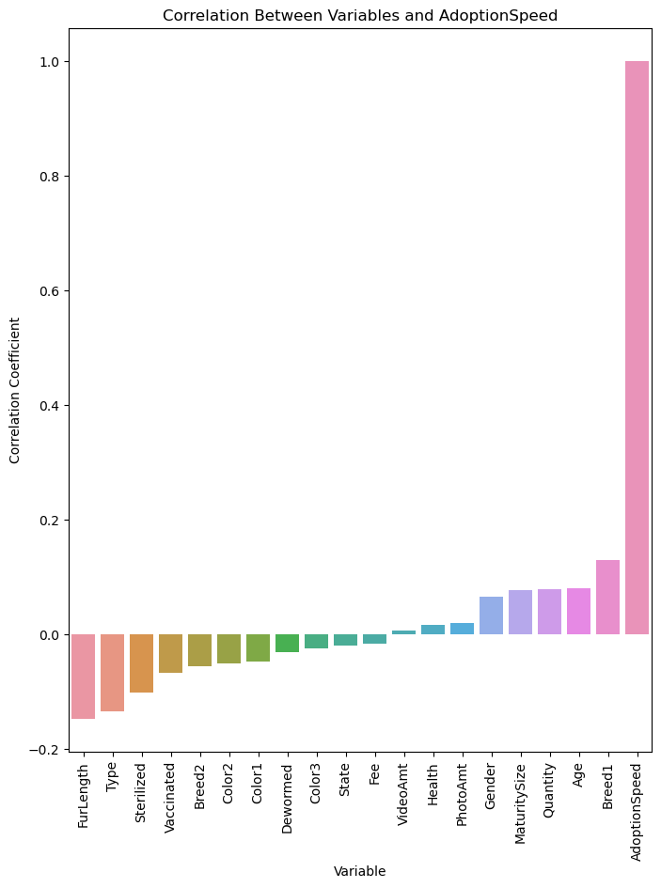
Feature Extraction
Calculated the correlation between all columns and the target variable after which we selected only the top 3 highest correlated values
Applying these calculations multiple times after the RandomOverSampling was different whether the Type is more correlated than the Furlenght or vice versa (Type was selected by performing multiple iteratinos).
We Selected Age, Breed1, and Type

Slide 19
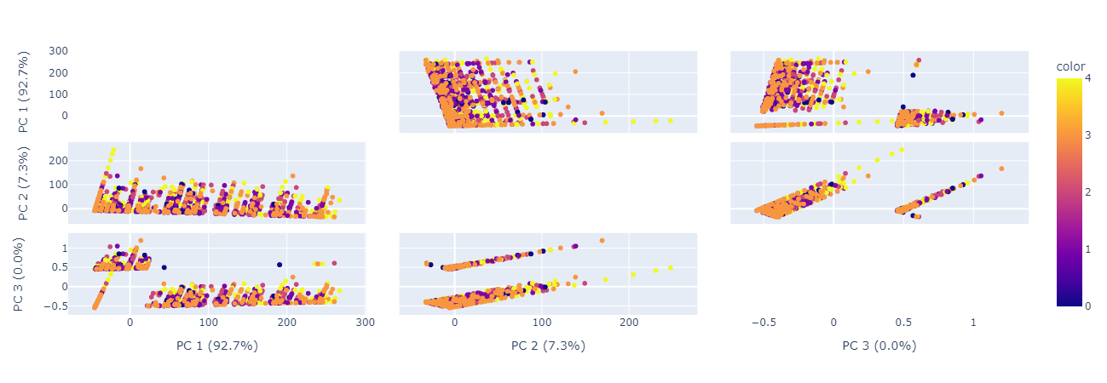
Applying PCA
Apply PCA over the most important features and select the top two pca components

Slide 20
Model Training
The four models are Logistic Regression, Decision Tree, Random Forest, and Naïve Bayes
All of the models are implemented in Python using pyspark framework
Each model is trained three times
On the features (Type, Age, Breed1) from the training dataset without any preprocessing or balancing for the classes
On the same set of features (Type, Age, Breed1) but after the preprocessing steps and class balancing that we explained before
On the training dataset after performing PCA and selecting the highest two components (Naive Bayes was not trained on this)
Naïve Bayes was both used by MLlib and implemented from scratch using map-reduce technique.
MLlib
Random Forest
Naïve Bayes
Logistic Regression
Decision Tree

Slide 21
Models’ Evaluation
F1 Score
 | Logistic Regression | Decision Tree | Random Forest | Naïve Bayes
On the features (Type, Age, Breed1) from the training dataset without any preprocessing or balancing for the classes | 0.245 | 0.296 | 0.298 | 0.201
On the same set of features (Type, Age, Breed1) but after the preprocessing steps and class balancing that we explained before | 0.193 | 0.297 | 0.295 | 0.235 (using MLlib)
 |  |  |  | 0.17 (using Map-Reduce)
On the training dataset after performing PCA and selecting the highest two components | 0.218 | 0.123 | 0.208 | N/A

Slide 22
Thank you

